Slide 1
Games Bootcamp
Monetisation

Slide 2
Recap
Optimisation

Slide 3
01
Monetisation Strategies

Slide 4
Monetisation Strategies
Strategies vary across platforms & genres. Most games fall into one of three categories:
Freemium:
Game is free
Revenue generated from in-app advertisements and in-game purchases.
Premium:
Players pay upfront to download and play.
Ad-free with optional IAPs
Subscription:
Regular payment model (monthly, annually).
Continuous access to content or premium features.
Can combine with Freemium for free entry-level access with premium benefits available for subscribers.
Notes:
There is a unity package but we will be making a basic solution to understand how the process would work.

Slide 5
In-App Advertising
Interstitial Ads:
Full-screen ads displayed at transition points (e.g., between levels).
Often come with a skip option after a few seconds.
Rewarded Videos:
Players choose to watch ads in exchange for in-game rewards.
Commonly offers currency, lives, or premium content.
Generally well-received as players opt-in and get rewarded.
Banner Ads:
Persistent or occasionally appearing small ads.
Placed at top or bottom of the screen.
Less intrusive but also less revenue per impression compared to interstitial ads.
Notes:
There is a unity package but we will be making a basic solution to understand how the process would work.

Slide 6
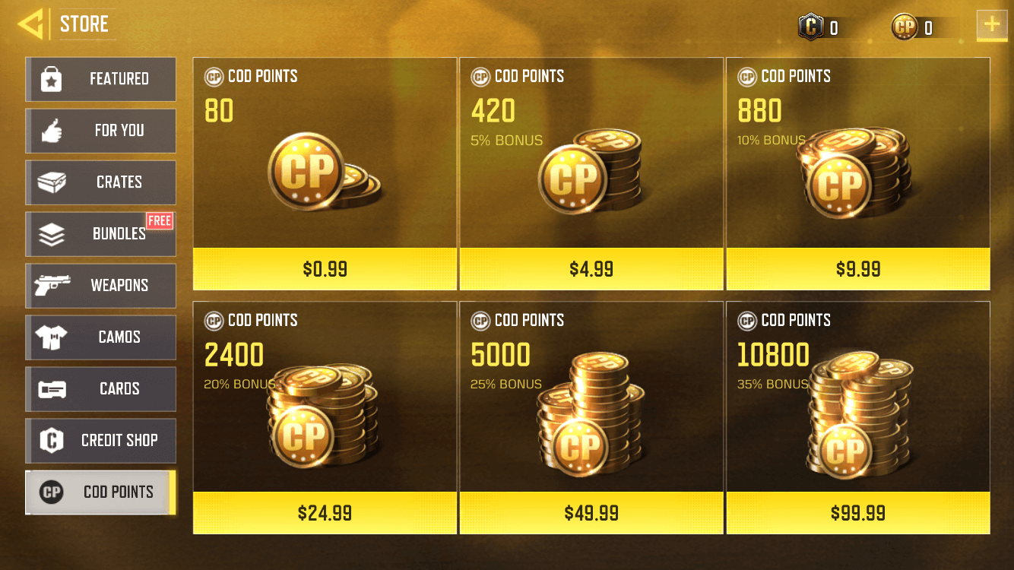
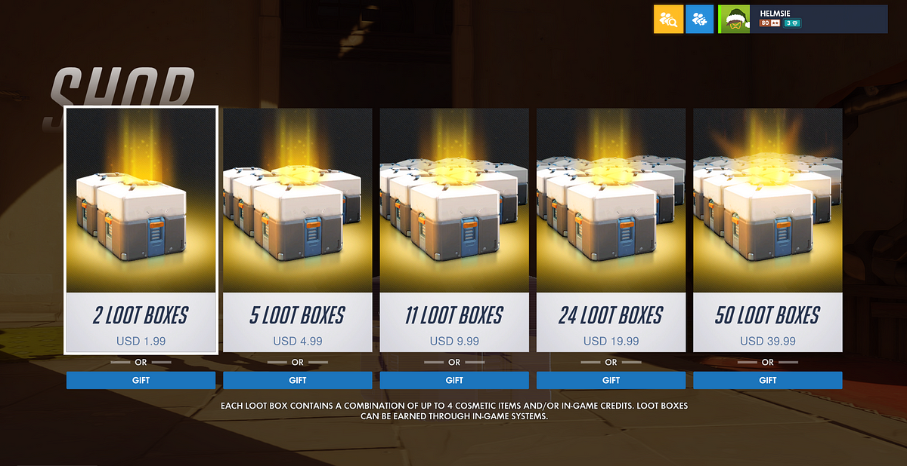
In-App Purchases
Consumable vs Non-consumable:
Consumable: Items that can be used once or have a limited lifespan (e.g., power-ups, currency).
Non-consumable: One-time purchases that last permanently (e.g., unlock a new level, remove ads).
Psychology Behind Successful IAP Design:
Scarcity: Limited-time items or sales prompt urgent action.
Convenience: Offering items that save time or effort can entice purchases.
Power of Choice: Allowing customization or unique content gives players a sense of ownership and identity, increasing likelihood of purchase.
Notes:
There is a unity package but we will be making a basic solution to understand how the process would work.

Slide 7
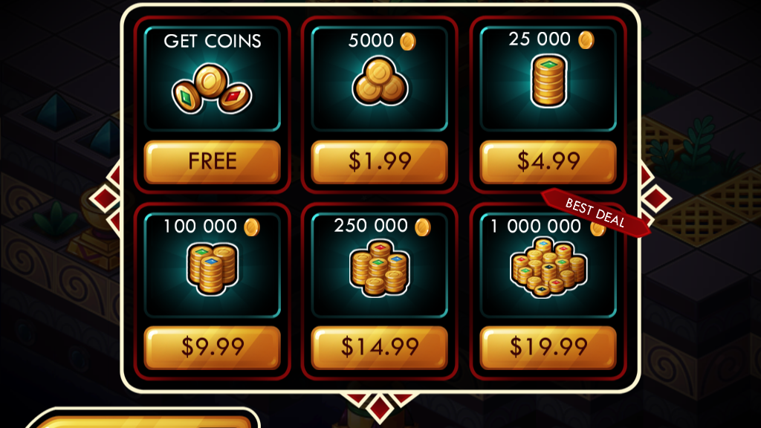
In-App Purchases
Psychology Behind Successful IAP Design:
Sense of getting a good deal (price ladder)
Sunk Cost Fallacy
FOMO
Notes:
There is a unity package but we will be making a basic solution to understand how the process would work.

Slide 8
Task
Design a monetisation strategy for your game
Download a mobile game on your phones and review it’s monetisation strategy in pairs
Where will you include interstitial, rewarded and banner ads.
Will you have IAPs and if so what will they sell?
Try and be specific about the placement and timing of ads as well as the pricing for them.
Notes:
There is a unity package but we will be making a basic solution to understand how the process would work.

Slide 9
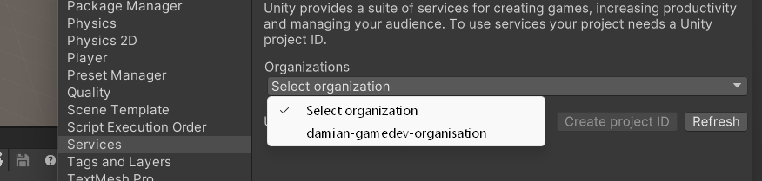
Unity Ads Setup
Unity Game Services : A collection of services for streamlining the development of common online features.
Login into Unity Game Services and name your organisation
In your Project make sure you are set to Android or iOS in the build settings
Under services enable ads. It will ask you to select your organisation
Click create project id
Notes:
There is a unity package but we will be making a basic solution to understand how the process would work.

Slide 10
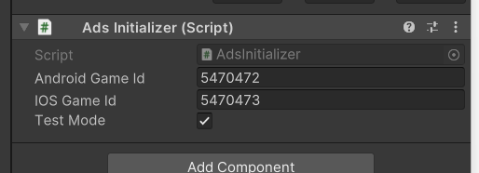
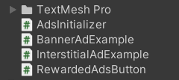
Unity Ads Setup
Use the package manager to install the latest version of Advertisement Legacy
Get your ids from the dashboard and add them to the initializer script
Run the game to initialize the ads package.
Add the example scripts to your scene and create three buttons for each AD type.
Notes:
There is a unity package but we will be making a basic solution to understand how the process would work.

Slide 11
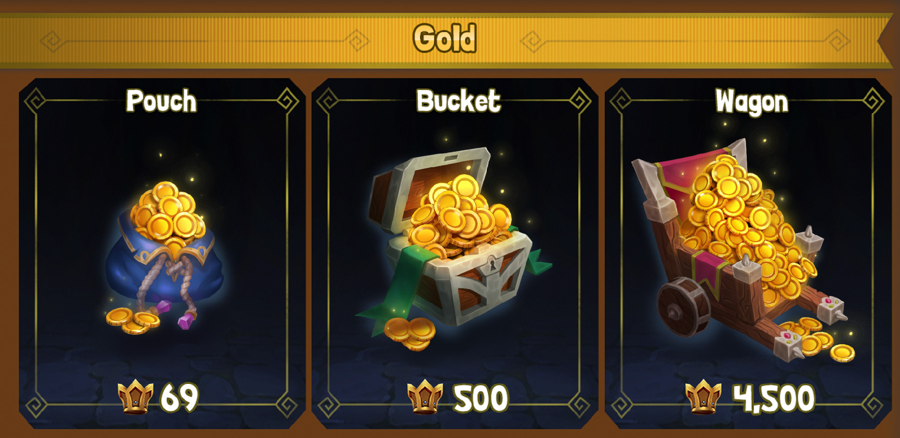
Task
Find a coin/gold pack from the Asset Store
Design a ‘store’ for your game.
For now we will only have coins that we can buy.
You will create three items.
The first gives you 50 coins for watching a rewarded ad
The next two are IAPs. and give you 250 & 1000 coins respectively.
Notes:
There is a unity package but we will be making a basic solution to understand how the process would work.

Slide 12
02
User Acquisition

Slide 13
User Acquisition Strategies
Organic Acquisition: Players discovering and downloading your game without direct advertising efforts.
Word of mouth.
Viral content or trends related to the game.
Positive reviews and ratings on app stores.
Search engine optimization (SEO) for game websites or forums.
Paid Acquisition: Investing in advertising or other paid methods to attract users.
Ads on platforms like Facebook, Instagram, YouTube. (Impressions)
Collaborations or partnerships with other apps or services.
Social Acquisition: utilizing the power of social media platforms for promotion.
Creating engaging posts or videos about your game on platforms like Facebook, Instagram, and Twitter.
Collaborating with influencers to showcase your game.
Hosting contests or giveaways to stir user engagement and shares.
Notes:
There is a unity package but we will be making a basic solution to understand how the process would work.

Slide 14
App Store Optimisation (ASO)
Keyword Optimization:
Research and implement keywords relevant to your game.
Ensure these keywords are present in the title, description, and other metadata.
Reviews and Ratings:
Encourage satisfied players to leave positive reviews.
Address negative feedback promptly and show potential players that you care about their experience.
Visual Assets:
High-quality icons, screenshots, and preview videos to attract potential players.
Regularly update visuals based on seasonal events or major updates.
Localization:
Translate and adapt your game's store listing for different languages and regions to appeal to a global audience.
Notes:
There is a unity package but we will be making a basic solution to understand how the process would work.

Slide 15
App Store Optimisation (ASO)
In-Game Rewards: Incentivize continued play and daily log-ins.
Daily Login Bonuses: Offer rewards that increase for consecutive daily logins.
Milestone Rewards: Give bonuses for achieving certain game milestones or completing challenges.
Social Features: Foster community and competition within the game.
Leaderboards: Let players compare scores or achievements.
Social Sharing: Allow players to share achievements, gifts, or challenges with friends.
Multiplayer Modes: Incorporate co-op or competitive modes to enhance engagement.
Regular Updates and Fresh Content: Ensure the game doesn't become monotonous and offers new challenges.
Seasonal Events: Introduce limited-time events or themes based on holidays or seasons.
New Levels or Modes: Add fresh challenges or game modes to renew interest.
Notes:
There is a unity package but we will be making a basic solution to understand how the process would work.

Slide 16
03
Game Analytics

Slide 17
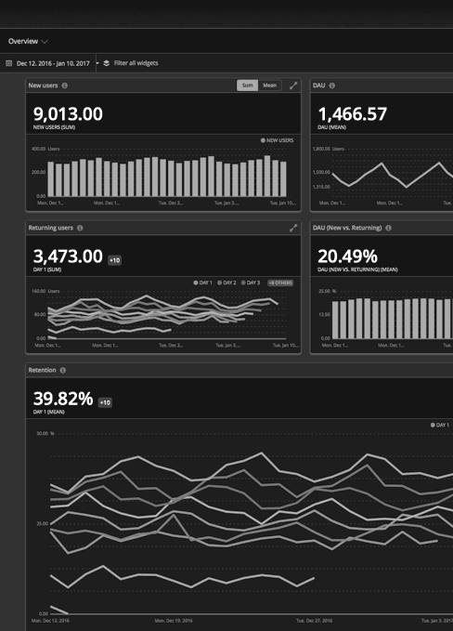
Analytics
Backbone of improving mobile games. They allow developers to understand players, optimize gameplay, and ensure longevity and profitability.
Behavioral Insights: Understand player habits, preferences, and pain points.
Performance Metrics: Track game's technical performance, like loading times and crash rates.
Monetization Analytics: Monitor how well in-game purchasing is performing and where potential revenue improvements lie.

Slide 18
Analytics Tools
Google Analytics for Firebase:
Real-time player analytics.
Integrates easily with many mobile platforms.
Tracks in-app purchases, ad interactions, and user events.
GameAnalytics:
Tracks more than just numbers, focusing on player behavior patterns.
Offers benchmarks to compare your game's performance against others.
Unity Analytics:
Built specifically for Unity-developed games.
Monitors player behavior, segment users, and view heatmaps of in-game activity.
Notes:
There is a unity package but we will be making a basic solution to understand how the process would work.

Slide 19
Analytics Tools
Data Interpretation:
Engagement Metrics: What parts of the game do players spend the most time on? Which features are ignored?
Drop-off Points: Identify levels or parts where players most frequently leave or uninstall the game. This could signal an imbalance or a bug.
Monetization Analysis: Are players making in-app purchases? If not, why? Maybe the prices are too high, or the value isn't apparent.
Incorporating Player Feedback:
Direct Communication: Platforms like in-game chats, forums, or official social media channels.
Feedback Collection: Use surveys or feedback forms within the game or sent via email.
Bug Reports: Create easy avenues for players to report glitches, crashes, or other issues.
Feature Requests: Encourage players to share ideas for new content or improvements.
Notes:
There is a unity package but we will be making a basic solution to understand how the process would work.

Slide 20
Analysis Tools
Iterative Development:
Feedback Loop: Continuously gather data, analyze, implement changes, and then gather more data to see the effects.
Frequent Updates: Regularly roll out new content, features, and fixes to keep players engaged and show that their feedback is valued.
Playtesting: Before major releases, have real players test new features or balance changes.
Notes:
There is a unity package but we will be making a basic solution to understand how the process would work.

Slide 21
Thanks!

